Slide 1
Final_Project
File created on: 11/10/2022 7:32:31 PM

Slide 2
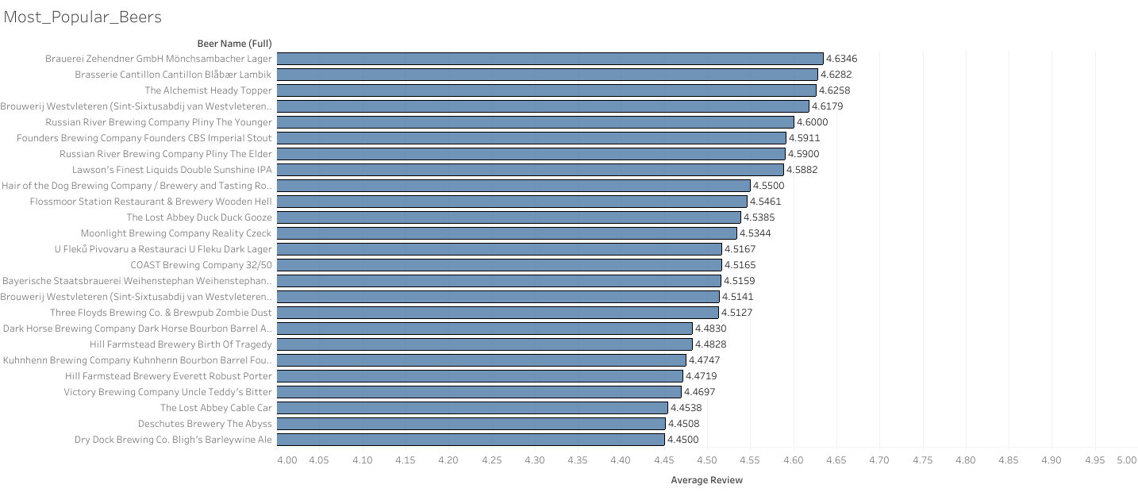

Slide 3
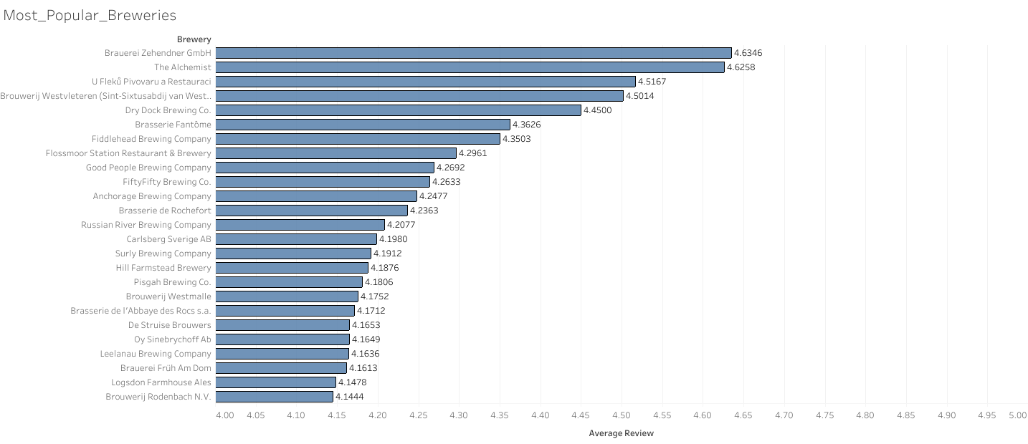

Slide 4
